Slide 1
Data Structures and Algorithms Lecture 5:
Analysis of Algorithms
Department of Computer Science & Technology
United International College

Slide 2
Outline
Algorithm
What is an algorithm?
How to describe an algorithm?
Analysis of Algorithms
Growth Rate and the Big-Oh Notation

Slide 3
What is an Algorithm?
A clearly specified set of simple instructions to be followed to solve a problem
Takes a set of values, as input and
produces a value, or set of values, as output
Data structures
Methods to manipulate data
Program = algorithms + data structures

Slide 4
An Algorithm May be Described
In English
As pseudo-code
As a program

Slide 5
Example for Algorithm Specification
Problem: Given a student score, decide whether the student Passes or Fails the course.
Algorithm:
English
Pseudo-Code
C Program
If the student’s score is greater or equal to 60, write "Pass".
Otherwise, write "Fail".
IF score >= 60
WRITE "Pass"
ELSE
WRITE "Fail"
#include <stdio.h>
void judge(int score)
{
if(score >= 60)
puts("Pass");
else
puts("Fail");
}

Slide 6

#include <stdlib.h>
Node* InsertNode(Node** phead, int index, double x) {
if (index < 0) return 0;
int currIndex = 1;
Node* currNode = *phead;
while (currNode && index > currIndex) {
currNode = currNode->next;
currIndex ++;
}
if (index > 0 && currNode == 0) return 0;
Node* newNode = (Node*)malloc(sizeof(Node));
newNode->data = x;
if (index == 0) {
newNode->next = *phead;
*phead = newNode;
}
else {
newNode->next = currNode->next;
currNode->next = newNode;
}
return newNode;
}
Pseudo-Code
A combination of human language and programming language
Mimics the syntax of a programming language
Ignores implementation details
A bridge from an idea to a program
How to Write Pseudocode?

Slide 7
Algorithm Analysis - Why
Why need algorithm analysis ?
writing a working program is not good enough
The program may be inefficient!
If the program is run on a large data set, then the running time becomes an issue

Slide 8
Example: One Of
Problem: Given an array A of n sorted values, check whether a value x is one of them.
Algorithm 1 (linear search):
FOR EACH value IN A
IF value = x
RETURN True
RETURN False

Slide 9
Example: One Of
Algorithm 2:
FOR EACH value IN A
IF value = x
RETURN True
ELSE IF value > x
RETURN False
RETURN False

Slide 10
Example: One Of
Algorithm 3 (binary search):
OneOf(A, l, r, x)
IF l>r
RETURN False
value = A[(l+r)/2]
IF value = x
RETURN True
ELSE IF value > x
RETURN OneOf(A, l, (l+r)/2-1, x)
ELSE
RETURN OneOf(A, (l+r)/2+1, r, x)

Slide 11
Discussion
Which algorithm is generally faster?
Algorithm 1 or 2?
Algorithm 2 or 3?
Describe an input instance (A, x) such that:
Algorithm 1 is the fastest of all
Algorithm 2 is the fastest of all
Algorithm 3 is the fastest of all

Slide 12
Assumption for Algorithm Analysis
We only analyze correct algorithms
Correct algorithms
For every input instance, halt with the correct output
Incorrect algorithms
Might not halt at all on some input instances
Might halt with a wrong answer

Slide 13
Algorithm Analysis - What
Algorithm analysis predicts the resources that an algorithm requires
Memory
Computational time (Efficiency)
Communication bandwidth
Power consumption
…

Slide 14
Algorithm Analysis - What
Factors affecting the computational time
Computer
Compiler
Algorithm used
Input to the algorithm
The input size (number of items in the input) affects the running time

Slide 15
Algorithm Analysis - What
Worst-case running time of an algorithm
The longest running time for any input of size n
An upper bound on the running time for any input
⇒ guarantee that the algorithm will never take longer
Example:
Search a linked list for a value, and the value is at the end
Best-case running time
The shortest running time for any input of size n
Average-case running time
May be difficult to define what “average” means

Slide 16
Worst-Case Cost
is the focus of our analysis

Slide 17
Algorithm Analysis - How
Time Cost of an algorithm is
The total number of basic operations performed
Arithmetical operations
Logical operations
Assignments
Return
Usually a function related to the input size
T(n) = 3n²+ 5n

Slide 18

Example
int sum(int n) {
int partialSum;
partialSum = 0;
for(int i=1; i<=n; i++)
partialSum += i*i*i;
return partialSum;
}
$$sum\left(n\right)=\sum_{i=1}^{n}{i^{3}}$$

Slide 19

Example
int sum(int n) {
int partialSum;
partialSum = 0;
for(int i=1; i<=n; i++)
partialSum += i*i*i;
return partialSum;
}
1: .……....................... 1
2: ............... 3n+2
3: ……......... 4n
4: ……................. 1
Cost Function: $T\left(n\right)=7n+4$

Slide 20
Side Note
With modern compilers, all of the three statements below consumes two basic operations: one addition, one assignment
i++;
i += 1;
i = i + 1;

Slide 21
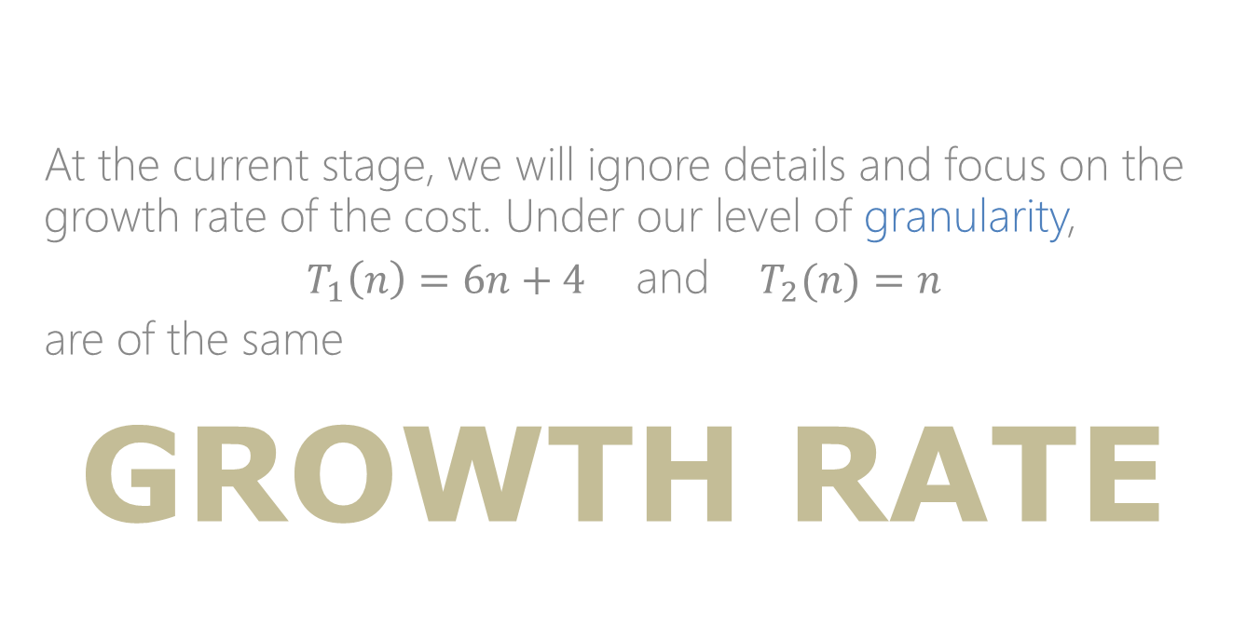
At the current stage, we will ignore details and focus on the growth rate of the cost. Under our level of granularity,
$T_{1}\left(n\right)=6n+4$ and $T_{2}(n)=n$
are of the same
growth rate

Slide 22
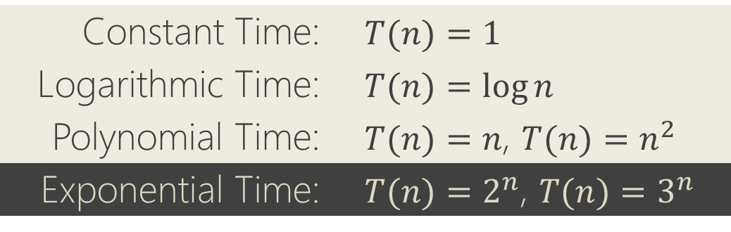
Growth Rate
Describes how fast the time cost increases as the input size increases
The idea is to establish a relative order among the cost functions
Applies only for large n
Typical Order Groups (A.K.A. Complexity Class)
Constant Time: | $$T(n)=1$$
Logarithmic Time: | $$T(n)=\log{n}$$
Polynomial Time: | $T(n)=n$, $T(n)=n^{2}$
Exponential Time: | $T(n)=2^{n}$, $T(n)=3^{n}$

Slide 23
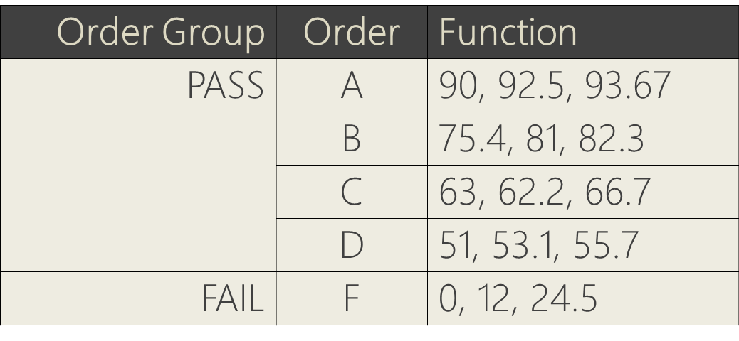
An Analogous Example
If we place these terms in our grading system …
Order Group | Order | Function
PASS | A | 90, 92.5, 93.67
 | B | 75.4, 81, 82.3
 | C | 63, 62.2, 66.7
 | D | 51, 53.1, 55.7
FAIL | F | 0, 12, 24.5

Slide 24
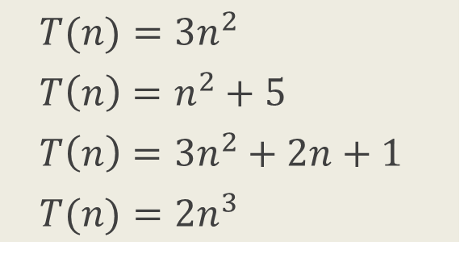
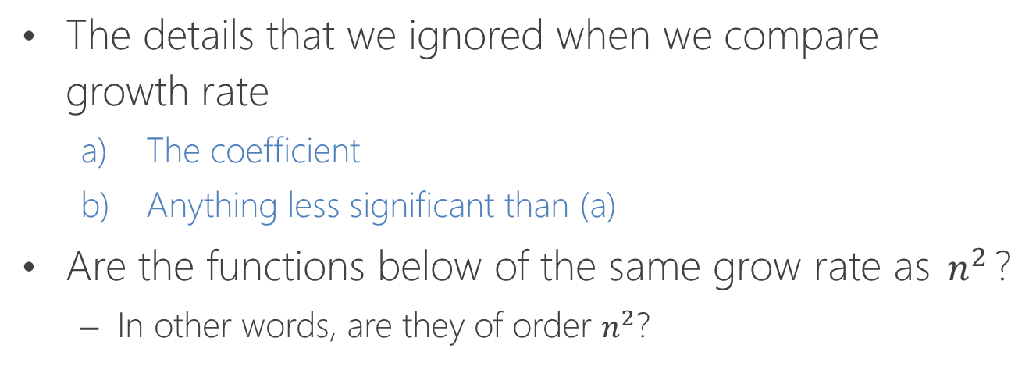
Growth Rate
The details that we ignored when we compare growth rate
The coefficient
Anything less significant than (a)
Are the functions below of the same grow rate as $n^{2}$?
In other words, are they of order $n^{2}$?
$$T(n)=3n^{2}$$
$$T\left(n\right)=n^{2}+5$$
$$T\left(n\right)=3n^{2}+2n+1$$
$$T(n)=2n^{3}$$

Slide 25
Comparing the GROWTH RATE
of cost functions

Slide 26
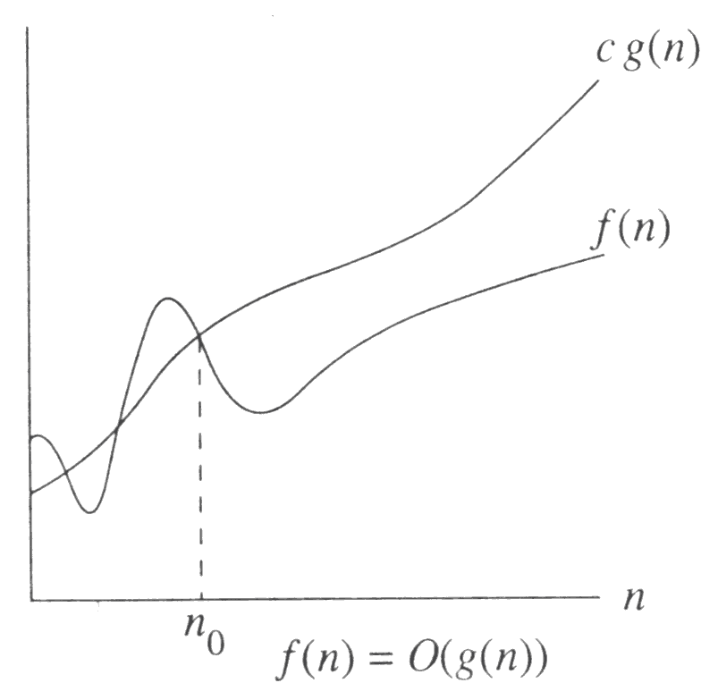
Big-Oh: The Upper Bound
f(n) = O(g(n))
Definition: There are positive constants c and n₀ such that
f(n) ≤ c g(n) when n ≥ n₀
The growth rate of f(n) is less than or equal to the growth rate of g(n)
f(n) grows no faster than g(n) for “large” n
g(n) is an upper bound of f(n)

Slide 27
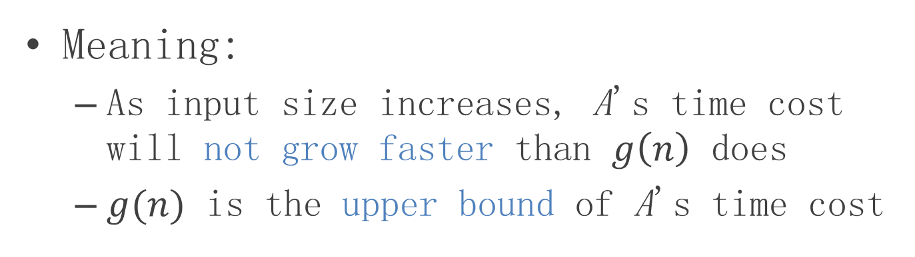
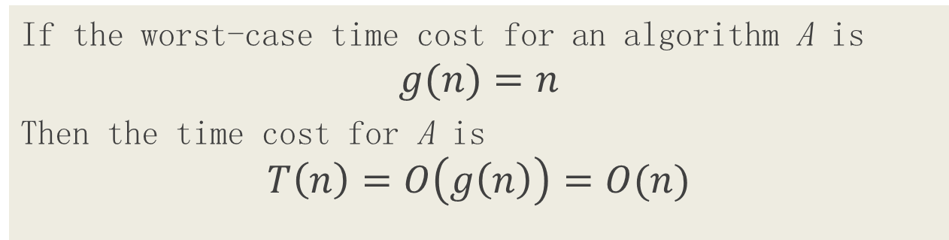
Understanding Big-Oh
If the worst-case time cost for an algorithm A is
$$g(n)=n$$
Then the time cost for A is
$$T\left(n\right)=O\left(g\left(n\right)\right)=O(n)$$
Meaning:
As input size increases, A's time cost will not grow faster than $g\left(n\right)$ does
$g(n)$ is the upper bound of A's time cost

Slide 28
Big-Oh: example
Let f(N) = 2N². Then
f(N) = O(N⁴)
f(N) = O(N³)
f(N) = O(N²) (best answer, asymptotically tight)
O(N²): reads “order N-squared” or “Big-Oh N-squared”

Slide 29
Big Oh: more examples
N² / 2 – 3N = O(N²)
1 + 4N = O(N)
7N² + 10N + 3 = O(N²) = O(N³)
log₁₀ N = log₂ N / log₂ 10 = O(log₂ N) = O(log N)
sin N = O(1); 10 = O(1), 10¹⁰ = O(1)
log N + N = O(N)
log^{k} N = O(N) for any constant k
N is O(2^{N}) but 2^{N} is not O(N)
2^{N} is O(3^{N}) but 3^{N} is not O(2^{N})

Slide 30
Math Review: logarithmic functions

Slide 31
Some Rules
When considering the growth rate of a function using Big-Oh
Ignore the lower order terms and the coefficients of the highest-order term
No need to specify the base of logarithm
Changing the base from one constant to another changes the value of the logarithm by only a constant factor
If T₁(N) = O(f(N)) and T₂(N) = O(g(N)), then
T₁(N) + T₂(N) = max(O(f(N)), O(g(N))),
T₁(N) * T₂(N) = O(f(N) * g(N))

Slide 32

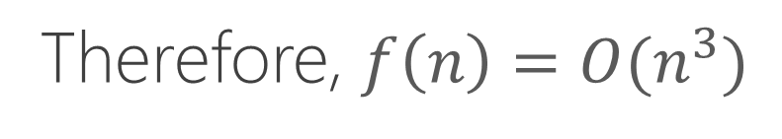
Application of the Rules
$$f\left(n\right)=5n^{3}+4n^{2}+3\log{n}$$
Coefficient
Lower Order Item
Lower Order Item
Therefore, $f\left(n\right)=O(n^{3})$

Slide 33
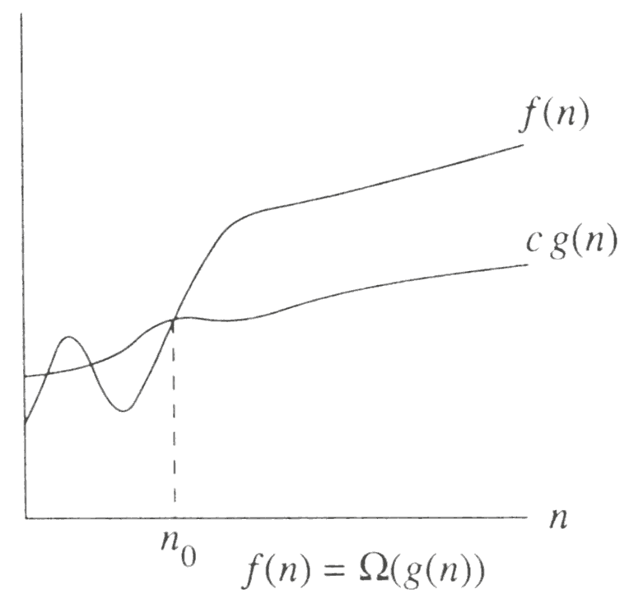
Big-Omega: The Lower Bound
f(n) = Ω(g(n))
Definition: There are positive constants c and n₀ such that
f(n) ≥ c g(n) when n ≥ n₀
The growth rate of f(n) is greater than or equal to the growth rate of g(n).
g(n) is a lower bound of f(n)

Slide 34
Big-Omega: examples
Let f(N) = 2N². Then
f(N) = Ω(N)
f(N) = Ω(N²) (best answer)

Slide 35
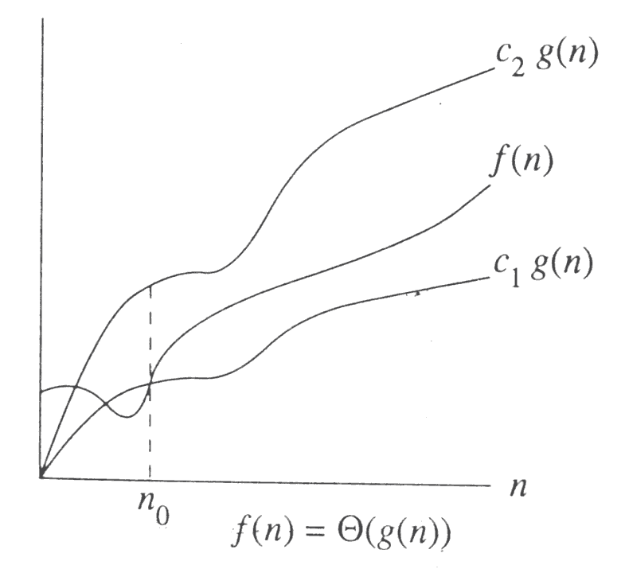
Big-Theta: Tight Bound
f(n) = Θ(g(n)) iff.
f(n) = O(g(n)) and f(n) = Ω(g(n))
The growth rate of f(n) equals that of g(n)
Big-Theta means the bound is the tightest possible

Slide 36
Some rules
If T(N) is a polynomial of degree k, then
T(N) = Θ(N^{k}).
For logarithmic functions,
T(log_{m} N) = Θ(log N).

Slide 37
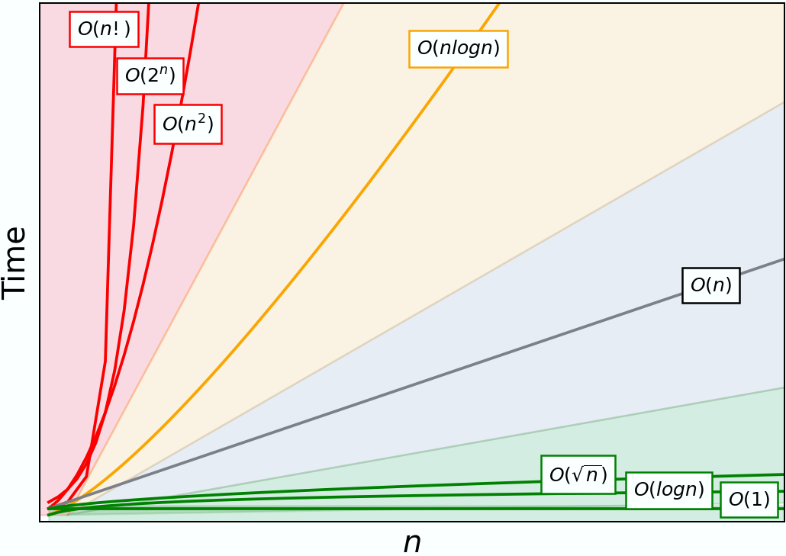
Typical Growth Rates

Slide 38
Growth rates …
Doubling the input size
f(N) = c ⇒ f(2N) = f(N) = c
f(N) = log N ⇒ f(2N) = f(N) + log 2
f(N) = N ⇒ f(2N) = 2 f(N)
f(N) = N² ⇒ f(2N) = 4 f(N)
f(N) = N³ ⇒ f(2N) = 8 f(N)
f(N) = 2^{N} ⇒ f(2N) = f²(N)
Advantages of algorithm analysis
To eliminate bad algorithms early
pinpoints the bottlenecks, which are worth coding carefully

Slide 39
Visualization
Visualization and Comparison of Sorting Algorithms
Algorithms used:
Introduction of Bubble, Insertion and Quick Sort
Selection Sort | Shell Sort | Insertion Sort
Merge Sort | Quick Sort | Heap Sort
Bubble Sort | Comb Sort | Cocktail Sort

Slide 40
Using L' Hopital's rule
L'Hopital's rule
If and
then =
Determine the relative growth rates (using L'Hopital's rule if necessary)
compute
if 0: f(N) = O(g(N)) and f(N) is not Θ(g(N))
if constant ≠ 0: f(N) = Θ(g(N))
if ∞: f(N) = Ω(g(N)) and f(N) is not Θ(g(N))
limit oscillates: no relation

Slide 41
How to determine growth rate?

Slide 42
General Rules 1
for loops
at most the running time of the statements inside the for-loop (including tests) times the number of iterations.
Nested for loops
the running time of the statement multiplied by the product of the sizes of all the for-loops.
O(n²)
for(i=0; i<n; i++)
for(j=0; j<n; j++)
k++;

Slide 43
General Rules 2
Consecutive statements
These just add up
O(N) + O(N²) = O(N²)
if(E) S1 else S2
never more than the running time of the test E plus the larger of the running times of S1 and S2.
for(i=0; i<n; i++)
k++;
for(i=0; i<n; i++)
for(j=0; j<n; j++)
k++;

Slide 44

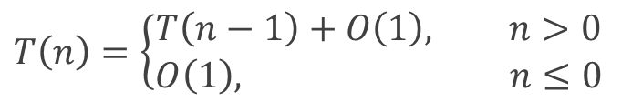
General Rules 3
Recursions
Find out the recurrence relation between cost functions of different inputs
Then solve the recurrence relation.
int sum(int n) {
if(n<=0)
return 0;
return n + sum(n-1);
}
$$T\left(n\right)=\left\{\begin{aligned}T\left(n−1\right)+O\left(1\right), n>0 \\ O\left(1\right), n≤0\end{aligned}\right.$$
$$T\left(n\right)=O(n)$$

Slide 45

Appendix: Solving Recurrence Relation
$$T\left(n\right)=\left\{\begin{aligned}T\left(n−1\right)+O\left(1\right), n>0 \\ O\left(1\right), n≤0\end{aligned}\right.$$
T(n) = T(n-1) + O(1)
= T(n-1) + 1
= T(n-2) + 1 + 1
= T(n-2) + 2
= T(n-3) + 3
= …
= T(n-i) + i
Let i=n:
T(n) = T(n-n) + n
= T(0) + n
= O(n)

